Slide 1
KBTU Music
Kozhakova Ulbossyn
Oral Almas
Nurzhanov Meiir

Slide 2
Idea
Recommendation is a class of machine learning that uses data to predict a user's preference for or rating of an item. We focused on recommending music based on user’s musical taste.
This project aims to create a free web-based music recommendation system able to estimate the user’s musical preferences and elaborate recommendations of several musical elements according to these preferences.

Slide 3
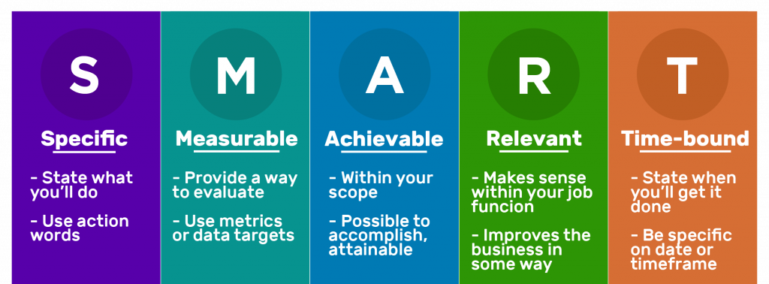
TARGET
We will create music recommendation system within next 6 months , which is gonna work on iOS & Android platforms at the same time without any crashes and failures in the free/ premium versions.

Slide 4
Types
Non-personalized
Popularity-based
Personalized
Item-item Collaborative Filtering
User-item Collaborative Filtering

Slide 5

Popularity-based
Data is sorted by the fields that indicate song’s popularity among users. It then gets recommended to a user

Slide 6
Item-item Collaborative Filtering
We compare liked songs of similar users and then recommend them what others like

Slide 7
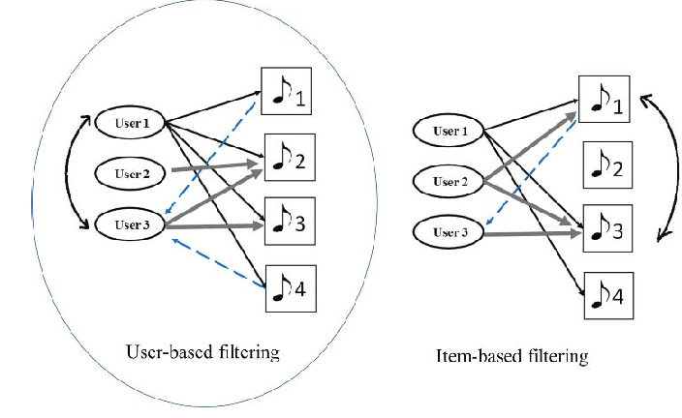
User-item Collaborative Filtering
User-item filtering is a hybrid between item-item filtering and user-user

Slide 8
Current situation
Dataset with approximately 10,000 songs
Non-personalized and personalized types of filtering songs
Music-filtering algorithms using machine learning

Slide 9
Ideal situation
App working on Android & Apple without any problems
Database with more than 100,000 songs
Improved, detailed filtering systems based on customers tastes
Customers from all around the world
Add premium version in order to provide more services

Slide 10
Countermeasures
Kbtu music | user-item collaborative filtering | has personalized and non-personalized approach to customers | sample data sets containing pretty enough amount of songs | uses latest technologies in order to provide better digital customer experience
Spotify | Advertisements and limited functionality still encourage some people to continue obtaining music illegally | Extreme audiophiles will be disappointed with the sound quality of streamed music | Received criticism from major artists, such as Taylor Swift and Thom Yorke, that the service does not give proper compensation to musicians | Works on nearly all modern smart phones, tablets, laptops and desktops
Grooveshark | No longer available | Consumed more data than current services | Placed users at risk of copyright infringement | Simple interface
8tracks | Limited Free App | Ads | Over Three Million Playlist Options | Explore Real Playlists
AppleMusic | No ad-based free streaming | Imported music is not backed up if phone is wiped | Sometimes playlists can be lost when phone is synced | Music from CD's can be imported to computer and synced over
LastFM | No longer streams radio stations without a paid subscription | Some users report app crashes | Available for Android and iOS | Intuitive recommendation engine

Slide 11


Technologies
Jupyter Notebook
Python

Slide 12

Why Python?
Powerful statistical and numerical packages like NumPy and Pandas
Easy and fast code writing

Slide 13

What we use?
NumPy Library

Slide 14
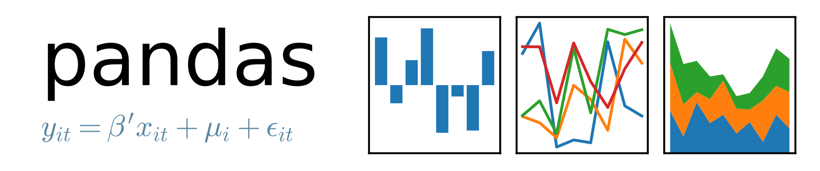
What we use?
Pandas Library

Slide 15
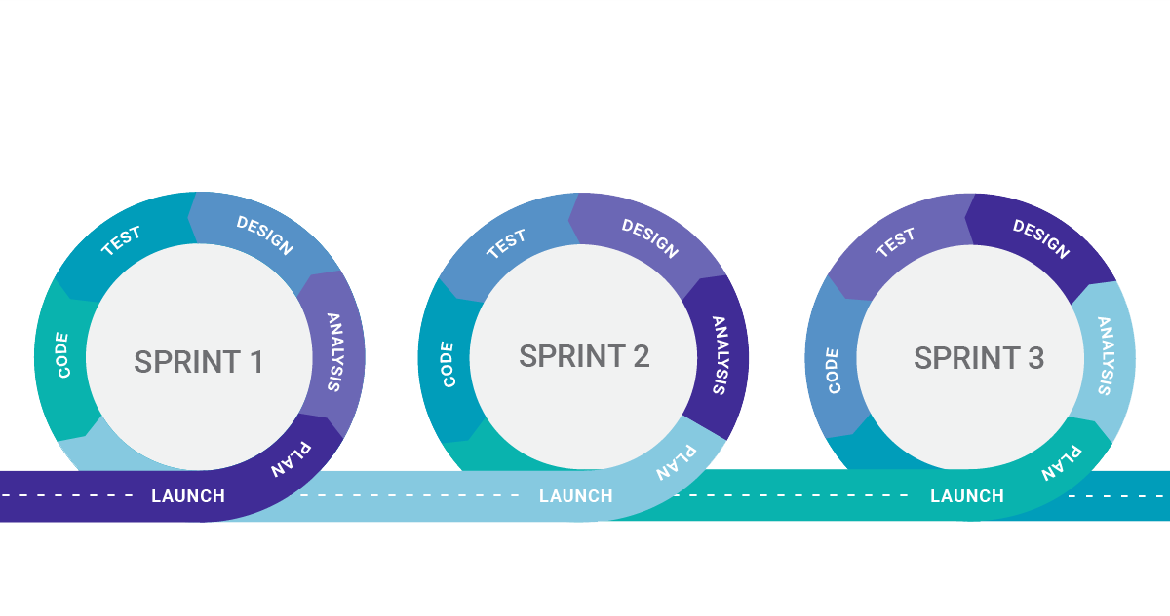
SDLC – Agile

Slide 16
Sample data set
“Million Songs Dataset Source” http://labrosa.ee.columbia.edu/millionsong/
Subset of the above data containing 10,000 songs https://github.com/turi-code/tutorials/blob/master/notebooks/recsys_rank_10K_song.ipynb

